Slide 1

TERM PROJECT
on
University Process Automation App
by-Team 1(EVEN)
SWE 4402
Software Requirements and Specifications
10th June,2024

Slide 2
1
TEAM MEMBERS
Nazifa Tasneem (210042114)
Namisa Najah Raisa (210042112)
Tasnia Anower Medha (210042124
ASSIGNED SYSTEM
Laundry System

Slide 3
RETROSPECTIVE
2
Interview Summary - Nafisa Tabassum Ava
Final-year EEE student, IUT
Preferences:
Suggestions:
Self-sufficient and simple system
User-friendly, no extra protocols
Punctual and reasonably priced services
Efficient laundry performance
Label clothes for specific users
Implement an alert system for service status
Introduce new services and adopt a more formal approach
Challenges:
Unaware if the laundry is open
Risk of skin diseases from unlabelled clothes
Difficulty finding specific clothes

Slide 4
RETROSPECTIVE
3
Interview Summary - Shakil Ahmed
Staff member with 4-5 years of experience in laundry operations
Preferences:
Suggestions:
Appreciates the manual system for its simplicity and adequacy
Finds current service offerings comprehensive and efficient
Integrate a digital system for ordering inventory to save time
Enhance communication channels between staff and management
Open to using technology to simplify tasks, particularly inventory management
Challenges:
Time-consuming process for ordering inventory products (detergents, brushes)
Need for improved communication between staff and management regarding inventory needs

Slide 5
RETROSPECTIVE
4
Interview Summary - Shaidul Alam
Admin member with 37 years of experience in laundry management
Preferences:
Suggestions:
Relies on a manually created system for managing operations
Values the simplicity and control of the manual system
Integrate digital solutions to enhance efficiency and adapt to the digital landscape
Improve communication systems between stakeholders
Develop covered or alternative drying solutions to mitigate the impact of the rainy season
Challenges:
Drying clothes under the open sky, problematic during the rainy season
Need for improved communication between stakeholders for better service delivery and customer satisfaction

Slide 6
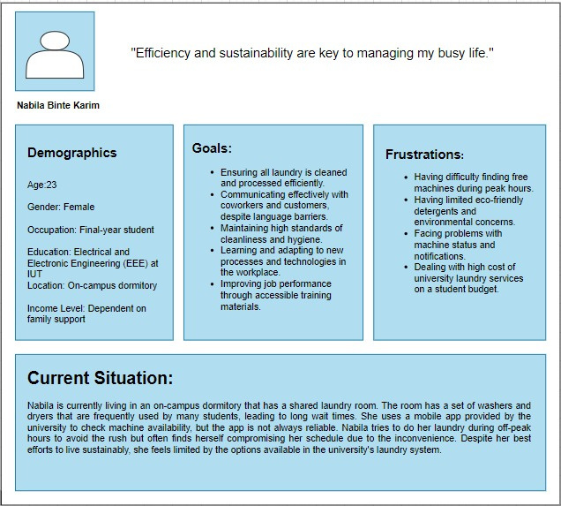
5
PERSONA

Slide 7
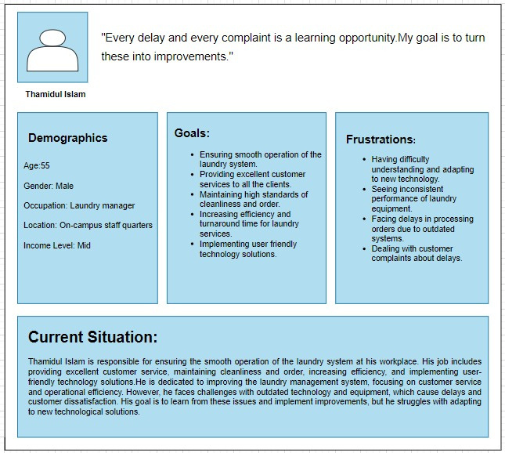
6
PERSONA

Slide 8
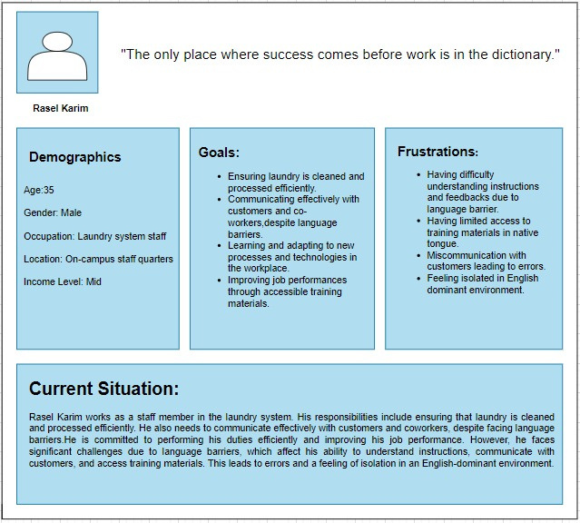
7
PERSONA

Slide 9
USER STORIES
8
For admins,
As an admin, I want to manage laundry operations through a digital system, so that I can enhance efficiency and have better control over the processes.
As an admin, I want an alternative drying solution to dry clothes efficiently even during the rainy season, so that I can avoid operational delays and inefficiencies caused by weather conditions

Slide 10
USER STORIES
9
As an admin, I want an improved communication system to enhance collaboration between stakeholders,
so that we can deliver better service and increase customer satisfaction.
As an admin, I want to schedule tasks and set reminders within the digital system, so that I can manage my daily tasks more efficiently and avoid missing important deadlines.

Slide 11
USER STORIES
10
For staff members,
As a staff member, I want to order inventory products through a digital system, so that I can save time and streamline the process of ordering supplies.
As a staff member, I want to communicate my inventory needs to management more efficiently, so that operational efficiency is improved through better communication.

Slide 12
USER STORIES
11
As a staff member, I want to schedule tasks related to inventory management within the digital system, so that I can manage inventory tasks more efficiently and avoid missing important deadlines.
As a staff member, I want to receive notifications when inventory levels are low, so that I can ensure we always have the necessary supplies to perform tasks effectively.

Slide 13
USER STORIES
12
For students,
As a student, I want to receive alerts when my laundry is complete or if the service is unavailable, so that I can plan my schedule better and avoid unnecessary trips.
As a student, I want my clothes to be labeled with my specific information, so that I can avoid mix-ups and reduce the risk of skin diseases.

Slide 14
USER STORIES
13
As a student, I want to check if the laundry service is available before I go, so that I can avoid wasted trips when the laundry is closed.
As a student, I want to be informed about new services offered by the laundry, so that I can take advantage of additional services that may be beneficial.

Slide 15
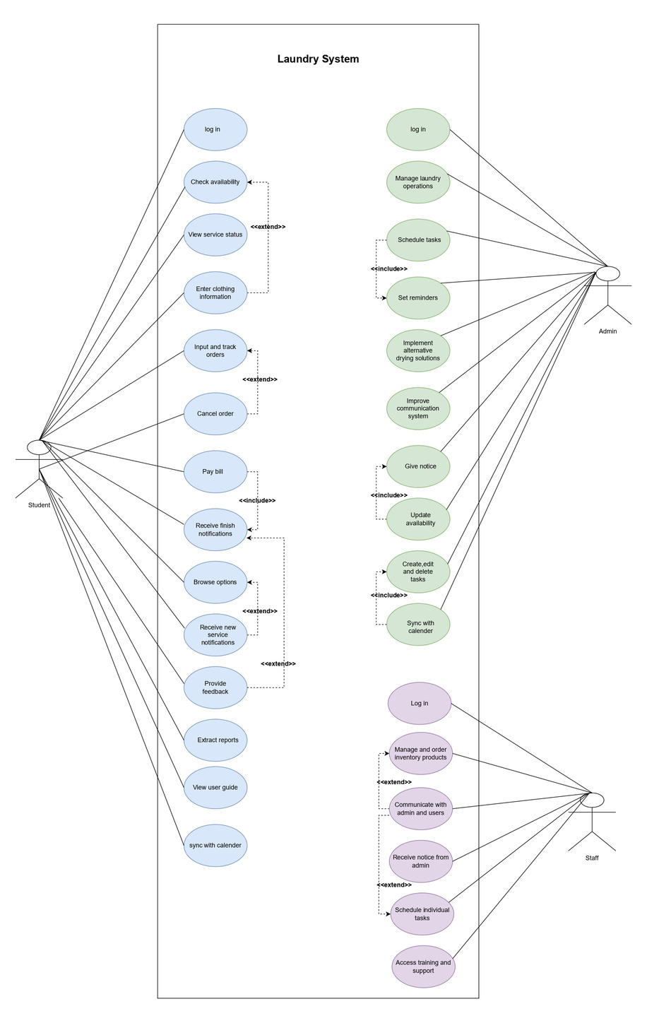
14
USE CASE DIAGRAM

Slide 16
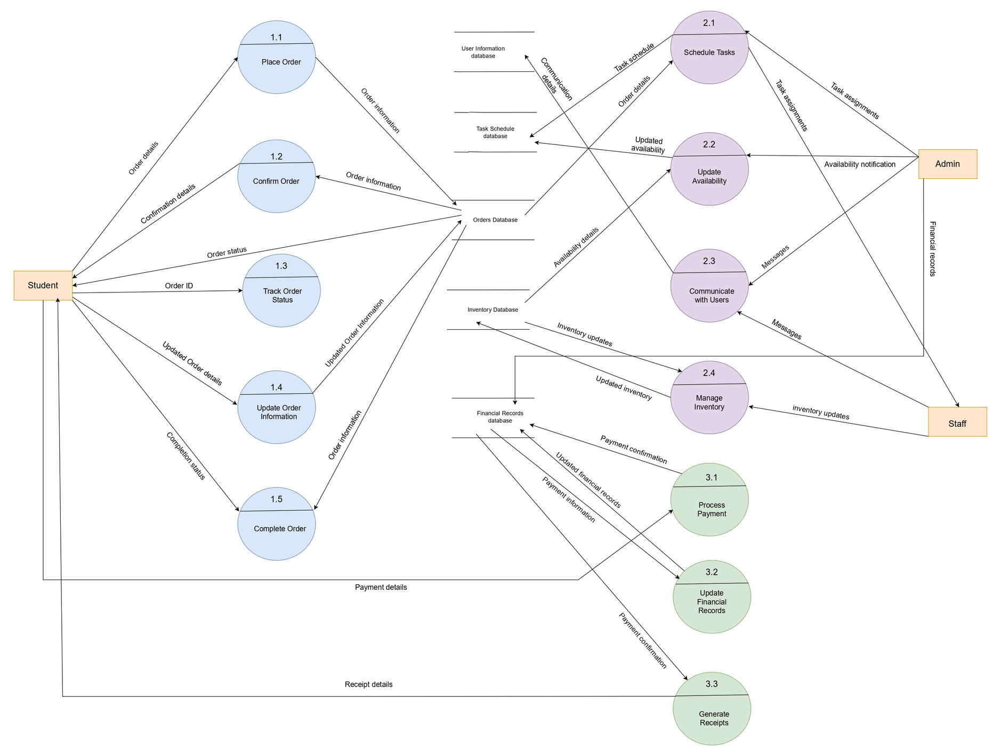
15
DATA FLOW DIAGRAM

Slide 17
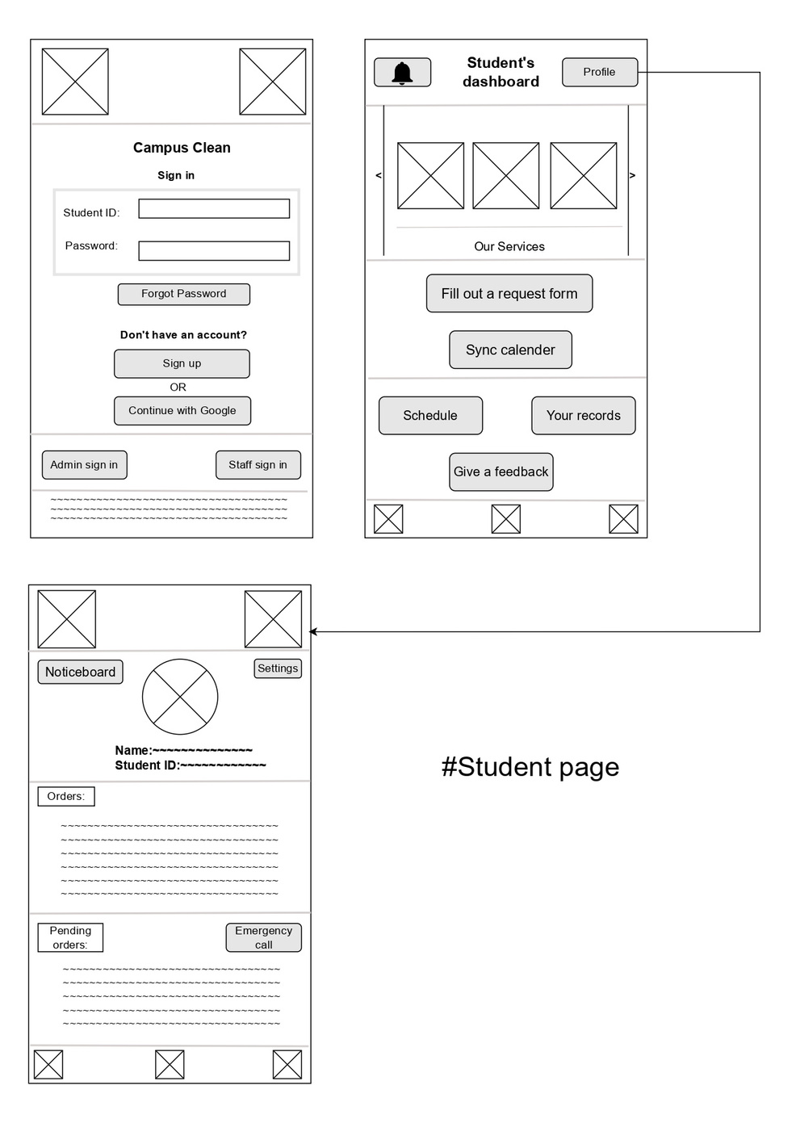
16
WIREFRAME

Slide 18
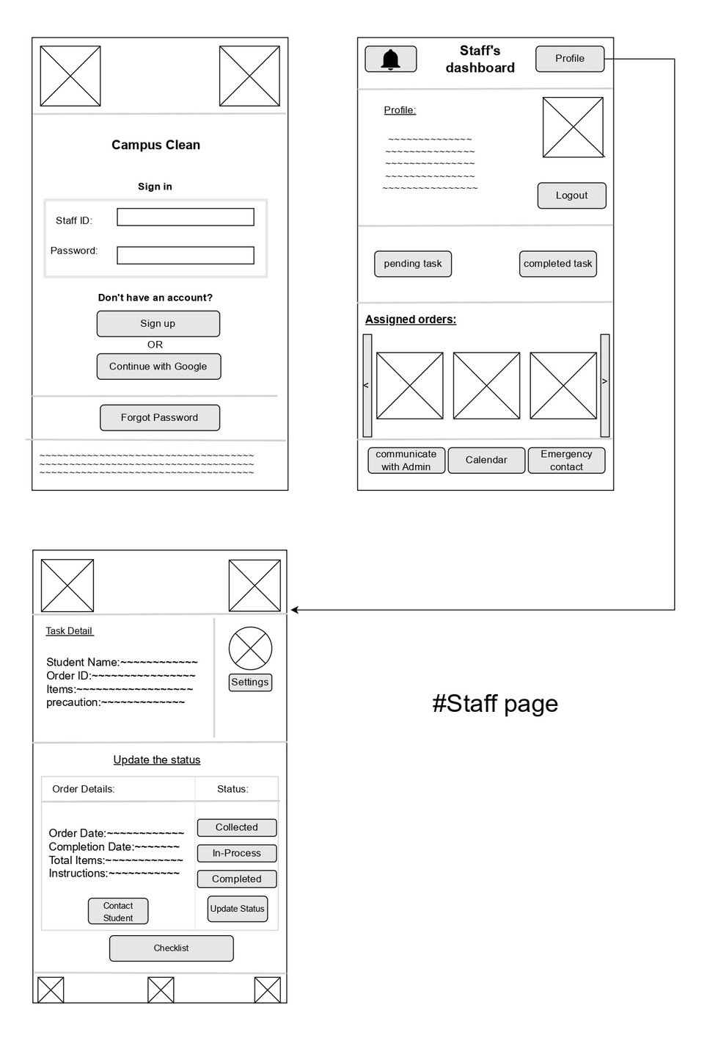
17
WIREFRAME

Slide 19
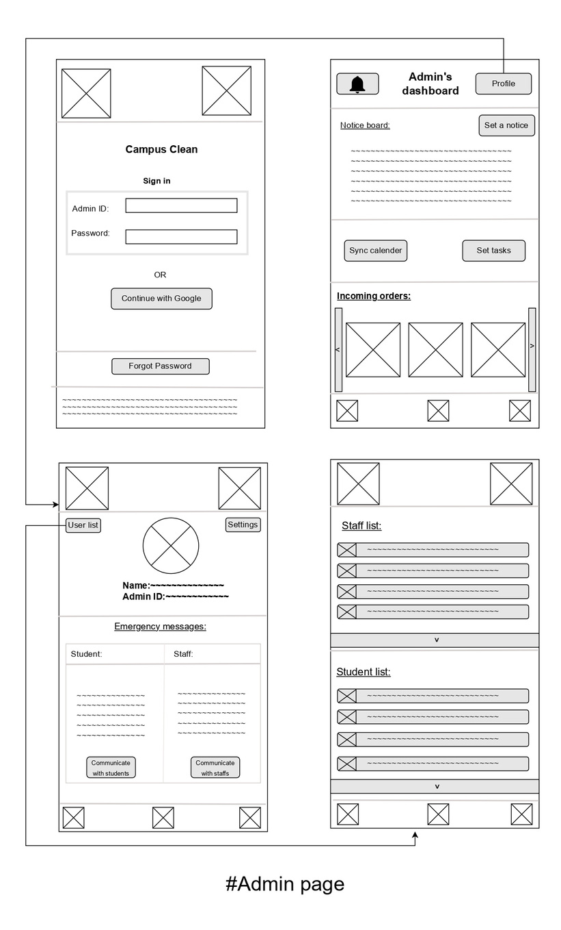
18
WIREFRAME

Slide 20
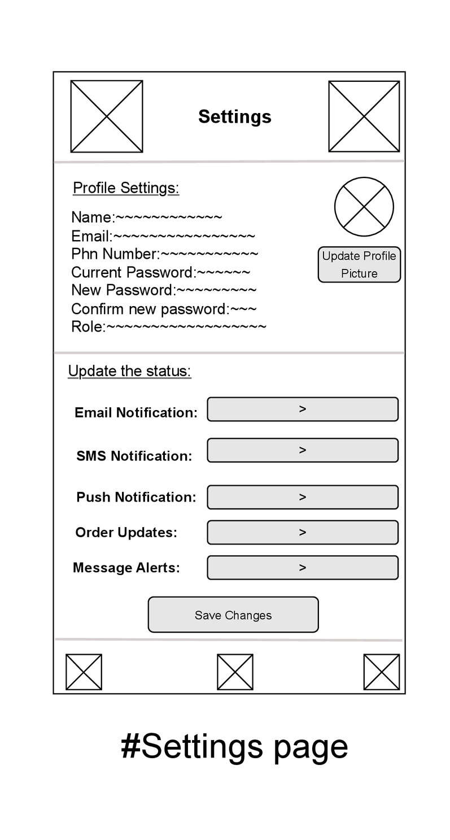
19
WIREFRAME

Slide 21
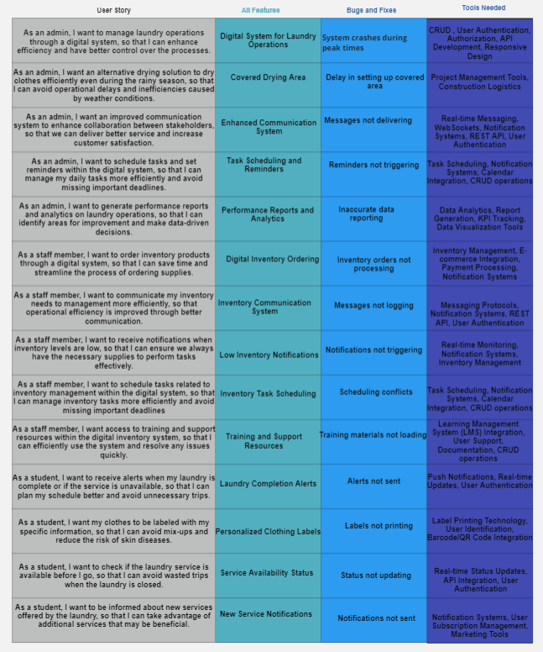
20
PRODUCT BACKLOG

Slide 22
THANK YOU

